Slide 1
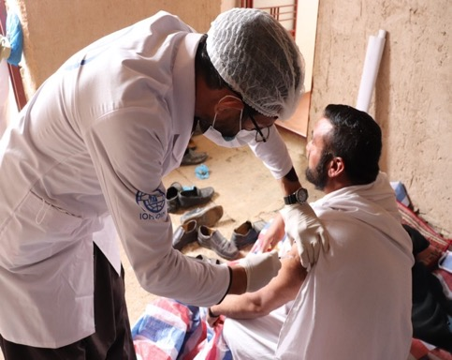
IOM COVID-19 vaccination in Afghanistan- reflections
Alice Wimmer, IOM
Senior Migration Health Officer
with special thanks to the Afghanistan IOM Migration Health Unit

Slide 2
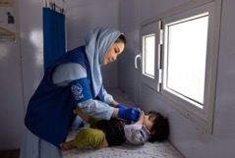
Migration Health key figures (2021)
Over 255,000 people assisted with essential health services
Over 600,000 Afghans screened for TB
19 mobile health teams , 50 Rapid Response teams and 4 COVID-19 hospitals
Almost 31,000 women & girls provided with reproductive health services
Nearly 35,000 psychosocial consultations
Over 1,200,000 Afghans reached with health education
Over 1,600,000 screened for COVID-19
Notes:
Services
Outpatient Consultation
Dispensing emergency medicines
Reproductive, Maternal and Child Health & Family Planning and Nutrition Programme
Trauma Care and Referral of emergency and complex cases to higher level facilities (through IOM ambulances)
Health promotion
Psychosocial Counselling
Referral
Location
Implemented in 93 Villages in 4 border province – Herat, Nimroz, Kandahar and Nangarhar in coordination with Ministry of Public Health, Health Cluster Partners, WHO, UNICEF, UNDP and UNFPA
Staffing
7 MHTs - 60 staff – Medical Doctor, Nurse, Midwife, MHPSS counsellor, Health Educator, IM Clerk, Pharmacy Assistant, Ambulance driver
Target beneficiaries
Returnees, refugees and other migrant population
People living in IDP settlements
People living in hard-to-reach, underserved host communities

Slide 3
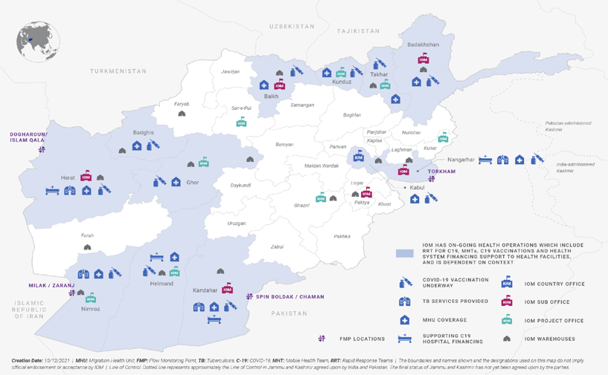
Migration Health Unit Operational Map

Slide 4
In coordination with MOPH, IOM implementing COVID-19 vaccination activities since October 2021 in 12 Provinces
Activities:
Administration of the COVID -19 vaccine
via 42 vaccinators linked to 19 mobile health teams
via implementing partners running COVID-19 hospitals linked to outreach vaccinators
mainly J&J, AZ and Sinopharm vaccines
RCCE
Populations of concern:
Returnee Afghans
Internally Displaced Persons (IDPs)
Person residing in hard-to-reach communities
Underserved host communities.

Slide 5
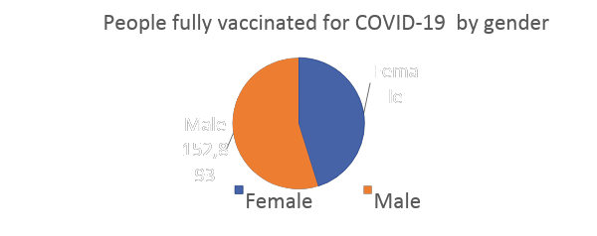
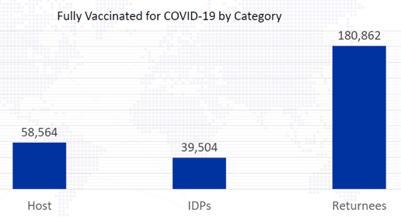
Main Achievement (October 2021 to 20 April 2022)
278,930 people vaccinated
MHTs 76,426
IPs 202,504
Fully vaccinated person are considered to have received single dose of J&J, or two doses of AstraZeneca & Sinopharm
Notes:
278,930 people
MHTs 76,426 (33,844 Female & 42,582 Male)
IPs 202,504 (92,193 Female & 110, 311 Male)
The 278,930 people vaccinated were reached through IOM MHTs (76,426 representing by category 35,057 host, 22,079 IDPs and 19,290 returnees and through IPs 202,504 representing by category 23,507 host, 17,425 IDPs and 161,572 returnees)

Slide 6
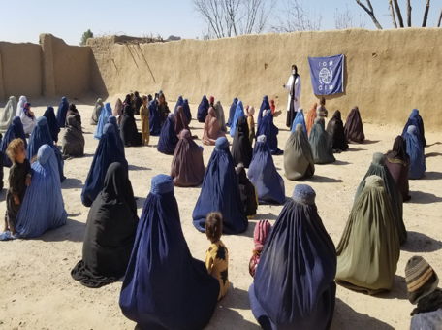
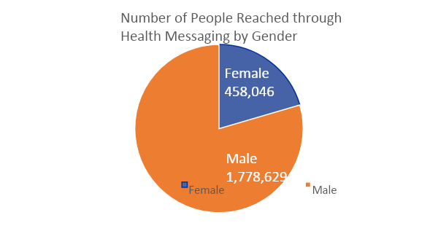
Main Achievement (October 2021 to 20 April 2022) cont.
RCCE reached 2,236,675 vulnerable people
Prisoners received vaccine doses
Female 458,046

Slide 7
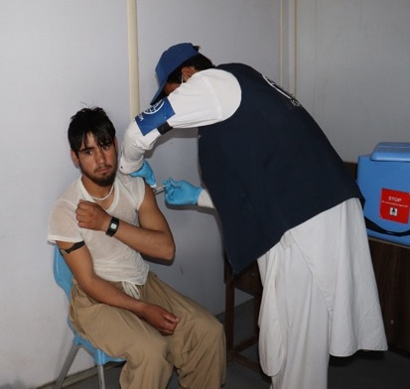
What worked well, as we know it
MHT to reach last mile/ remote locations
Local IPs, facilitated the activities in location where IOM MHTs had limited/no access (Helmand province)
Female vaccinators and male vaccinators
RCCE messages were integrated in the normal health education session

Slide 8
The ‘déjà-vue’ challenges
Shortage of vaccines availability in the country
Short shelf life of supplied vaccines (3 -4 months) and weak supply chain management
Hesitance: wrong information/misconception towards the COVID-19 vaccine at community levels (around fertility, growth of fetus, newborn or child, death of adult…)
Security incidents
Sporadic difficulties of female staff to access their workplaces

Slide 9
Other challenges & food for thought
Geographical and seasonal situations (snow/flooding) contributed to reduce access to populations and/or health centers (NB : shelf life!)
High mobility of the targeted beneficiaries 🡪 IOM staff/ IPs were not always able to track people for 2nd dose
Forecasting/ planning taking other factors into account, enabling also rapid reaction to supply/ demand fluctuations linked to:
weather,
seasonal (labour) migration
insecurities
🡪 IOM ‘MoRIA’ approach, expansion to additional hard-to-reach areas and major mobility corridors

Slide 10
Mobility centered Routine Immunization Approach (MoRIA) Framework to increase route immunization coverage and essential health care services
among migrants and mobile populations
Objective: to reach more children/ adults in underserved communities, remote locations, along mobility corridors and thus increase global immunization coverage
This brings together IOM’s comparative advantage in the field of Health and DTM
Aims to complement traditional vaccination programming methods with Population Mobility Mapping (PMM)
PMM is used to characterize mobility patterns, population distribution, spaces of vulnerability (SoV), health facilities and mobility corridors which are overlayed with vaccination coverage data
🡪 priority areas for intensified and adapted vaccination activities, particularly in difficult-to-reach areas.
Targeted population:
Migrant population within the corridors
Returnees, refugees and displaced populations
Nomads (seasonal and others)
Long distance travelers

